Slide 1







Slide 2
How to Implement
Data Engineering
in Practice

Slide 3
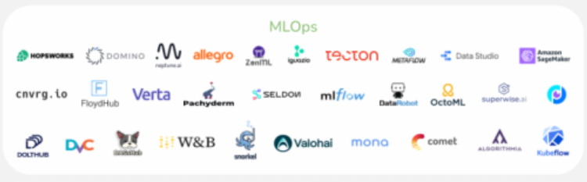
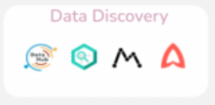
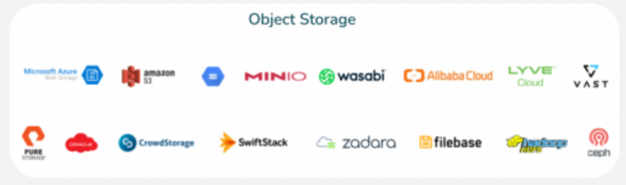
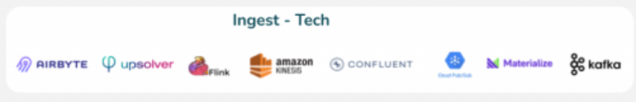
How to Implement Data Engineering in Practice
Data Discovery
MLOps
Object Storage
Ingest - Tech

Slide 4
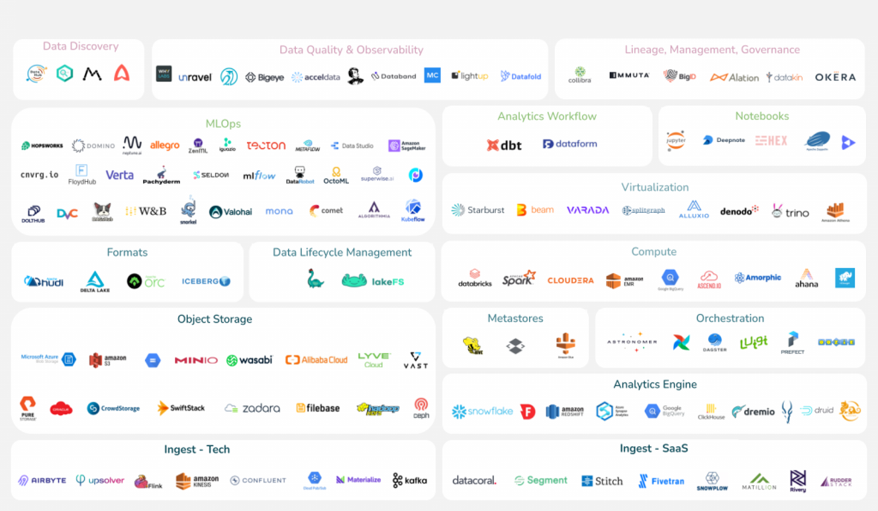
How to Implement Data Engineering in Practice?
Data Discovery
Observability
Governance
MLOps
Workflow
Notebooks
Virtualization
Formats
Data Lifecycle
Compute
Object Storage
Metastores
Orchestration
Analytics Engine
Ingest - Data
Ingest - Application

Slide 5
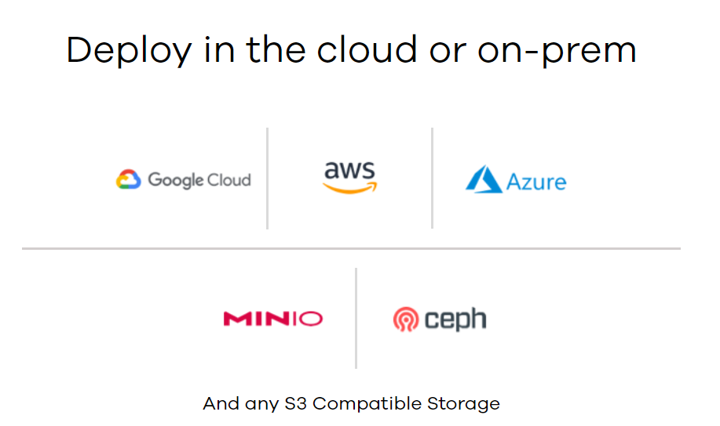

Slide 6


Slide 7
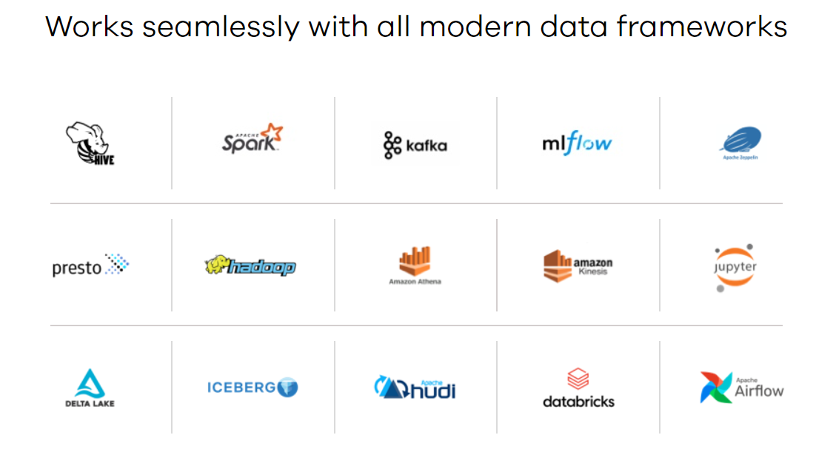

Slide 8
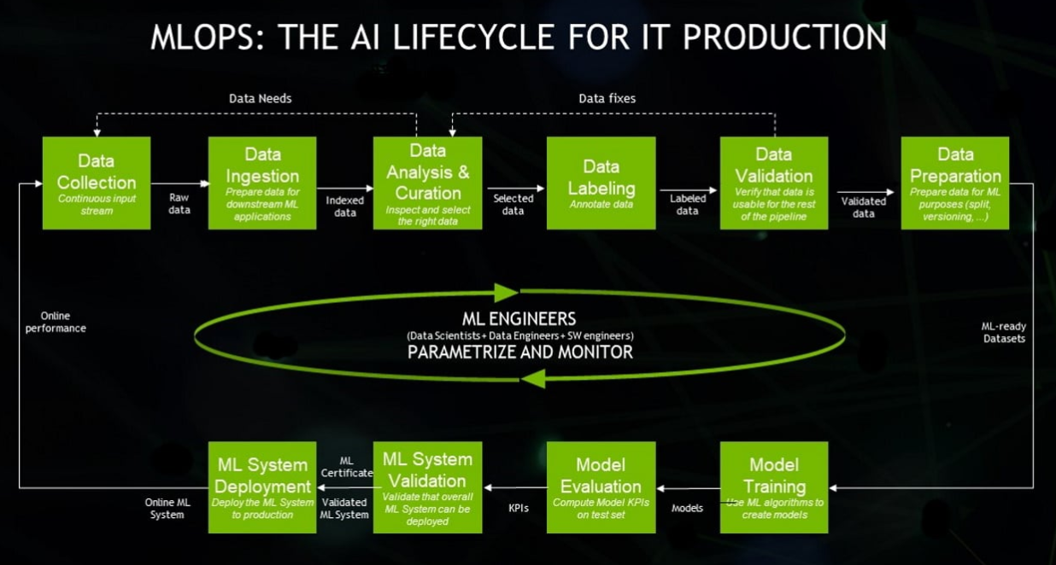
MLOps (Machine Learning Operations)

Slide 9


MLOps (Machine Learning Operations)
Data
Collection
Data
Ingestion
Data
Analysis
Data
Labeling
Data
Validation
Data
Preparation
Forecast
User
Machine
Learning
Deployment
Machine
Learning
Validation
Model
Valuation
Model
Training

Slide 10







Slide 11
How to Implement
Data Engineering
in Practice ?

Slide 12

MLOps (Machine Learning Operations)
Layer 1 - Data
Data
Collection
Data
Ingestion
Data
Analysis
Data
Labeling
Data
Validation
Data
Preparation
Layer 2 – Machine Learning
Forecast
User
Machine
Learning
Deployment
Machine
Learning
Validation
Model
Valuation
Model
Training

Slide 14
Software Engineering
Data
Application
Data Science
BigData
Insights
Data Engineering
Data Collection
Data Preparation

Slide 15
Governance
Observability
Data Discovery
MLOps
Workflow
Notebooks
Virtualization
Object Storage
Anaylics
Ingest Data
Ingest App
Data LifeCycle

Slide 16
Governance
Observability
Data Discovery
MLOps
Workflow
Notebooks
Virtualization
Object Storage
Anaylics
Ingest Data
Ingest App
Data LifeCycle

Slide 17
